Slide 1
جامعة بنها-كلية التربية قسم اللغة الانجليزية دراما وائل محمد عبد الحكم
الفصل الدراسي الثاني 2019-2020

Slide 2
Plot
How dramatists buid up theirplots to support their messages
Traditional Plot Structures
Aristotle Dramatic structure
Freytag’s Pyramid

Slide 3
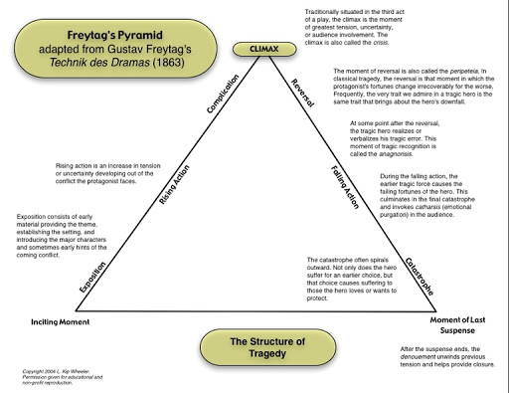

Slide 4
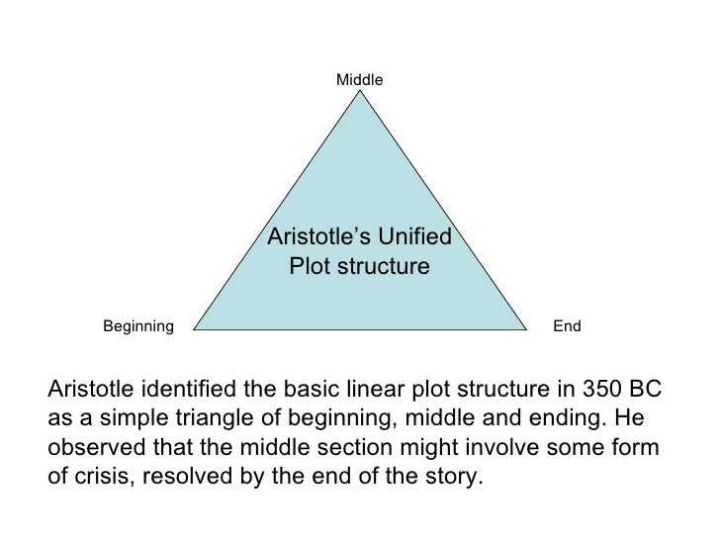

Slide 5
Visit this website for activities on Plot Structure and then apply to the plays assigned
https://www.storyboardthat.com/articles/e/five-act-structure

